Slide 1
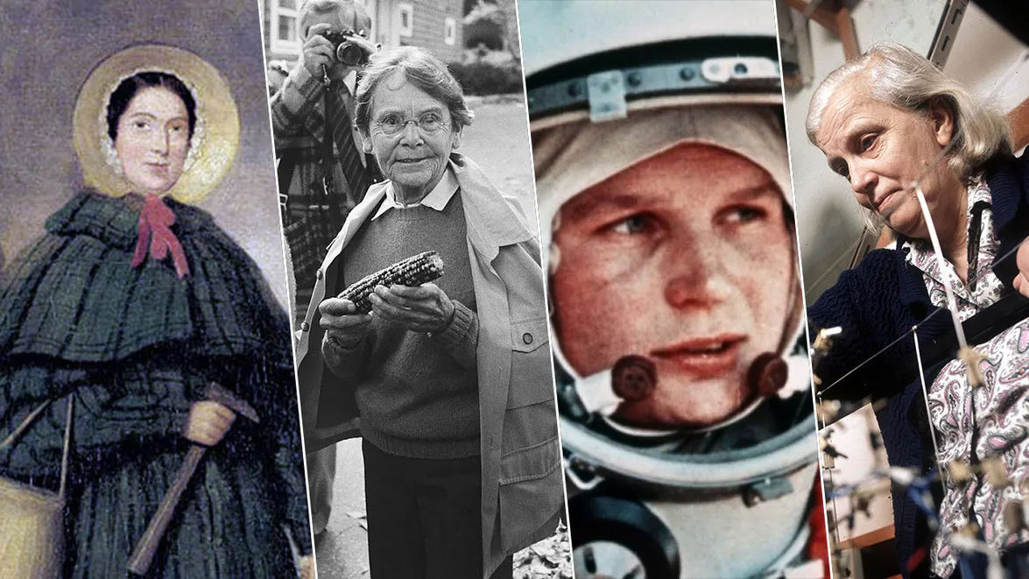
INTERNATIONAL DAY OF WOMEN AND GIRLS IN SCIENCE February 11th, 2025
Presentation prepared by: Saida Delić, English Teacher
Džinić Ajla, Student
Mujkić Amina, Student

Slide 2
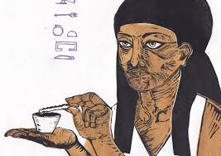
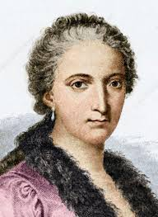
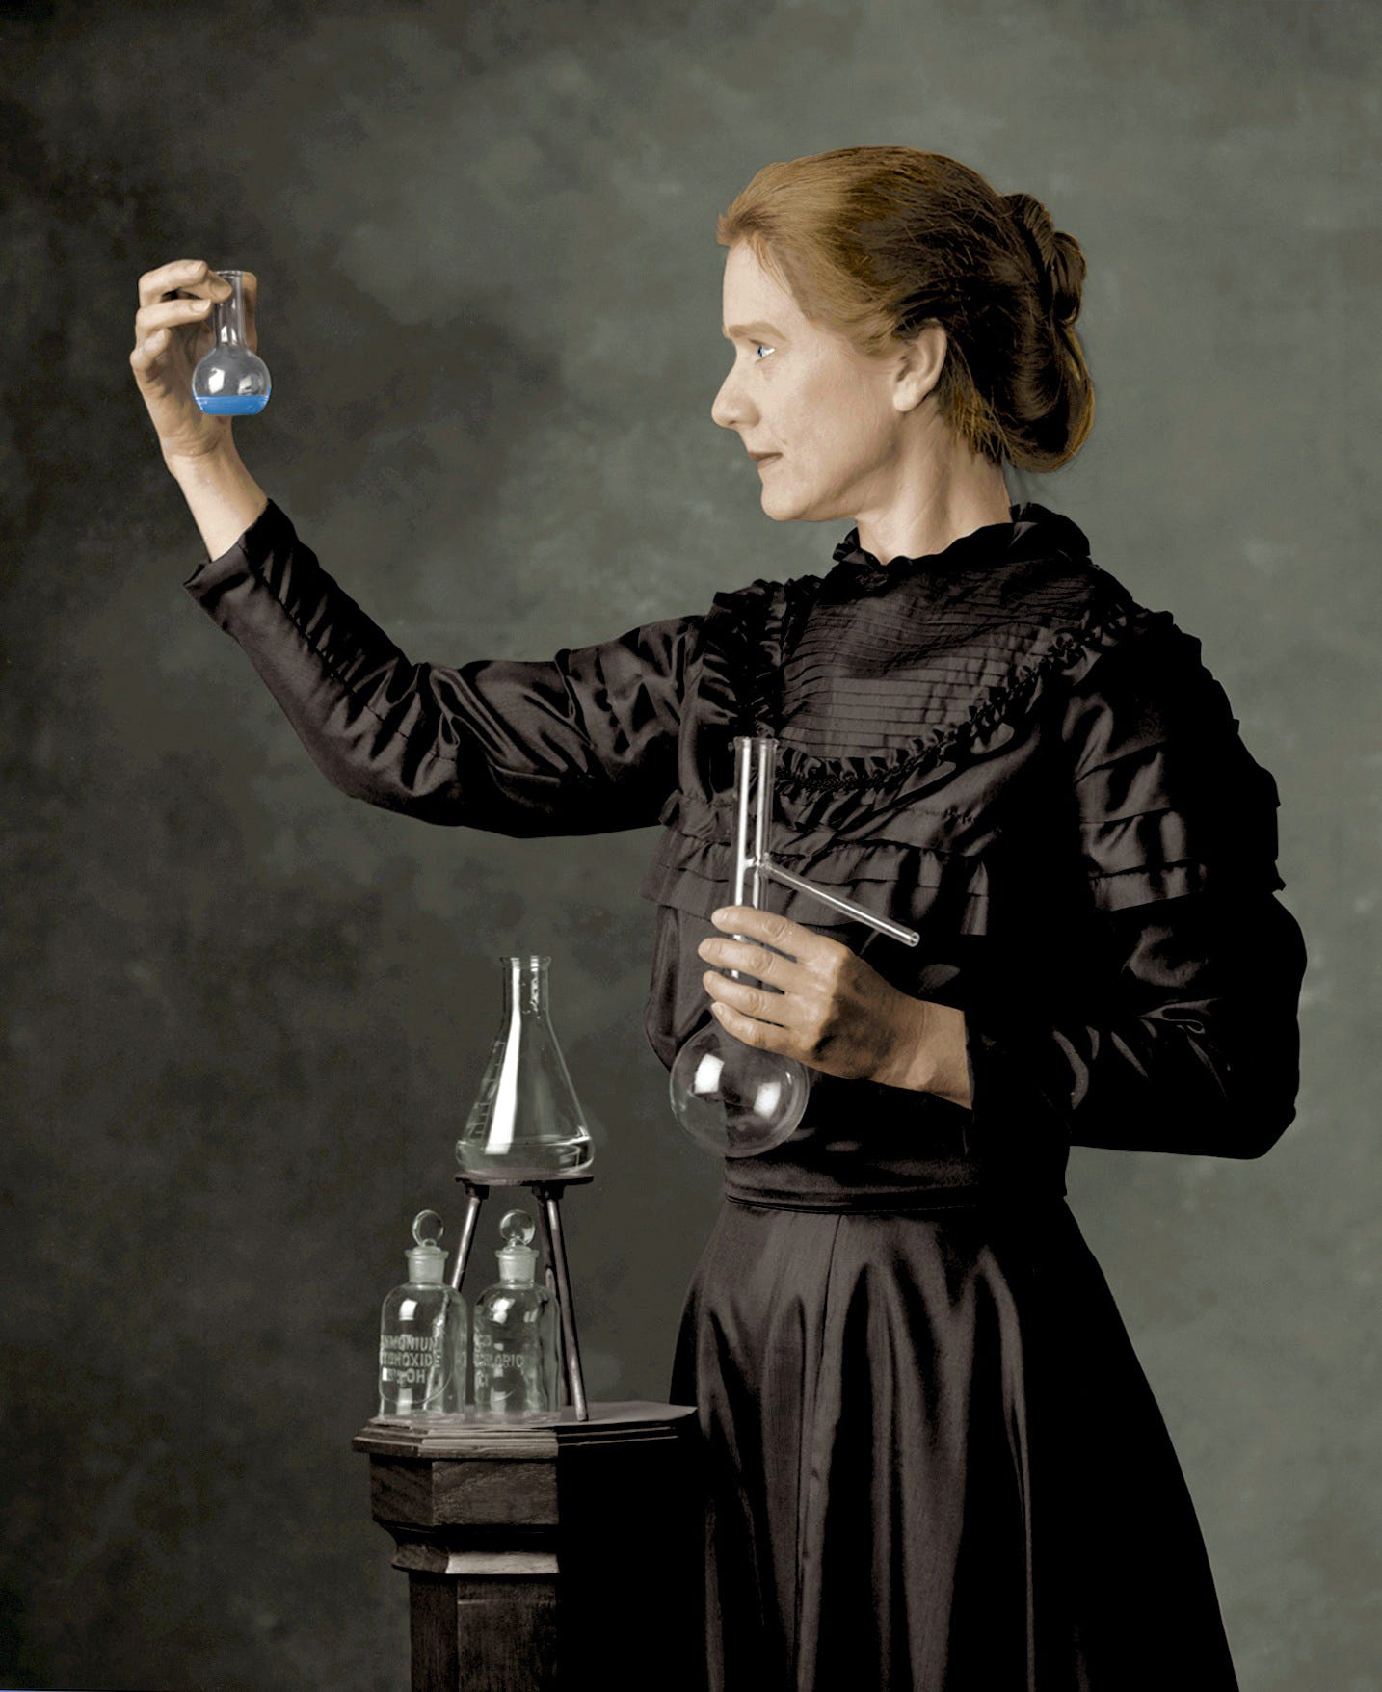
Merit Ptah – the Egyptian doctor, 2700 BCE
Maria Gaetana Agnesi –the first renowned female mathematician in the West, 1718-1799
Marie Curie – the first woman to recieve the Nobel Prize in 1903 for the contribution in the field of physics.

Slide 3
WOMEN FACING CHALLENGES
Unequal pay Racial injustice Gender-based violence
Inadequate healthcare Threats to reproductive rights Lack of education
Food insecurity Climate change Unequal political representation
Discriminatory social institutions Human trafficking Limited freedom of movement
Threats during migration Discrimination based on disability Poor mental health
The digital divide Online harassment Unpaid labor
Inadequate maternal healthcare Period poverty

Slide 4
Pioneering Women In Science History
Rosalind Franklin
Contributed to the discovery of the structure of DNA
A model of the rover bearing Rosalind Frnklin‘s name

Slide 5
Beatrice Shilling Daredevil motorcyclist and engineer who saved fighter pilots' lives

Slide 6
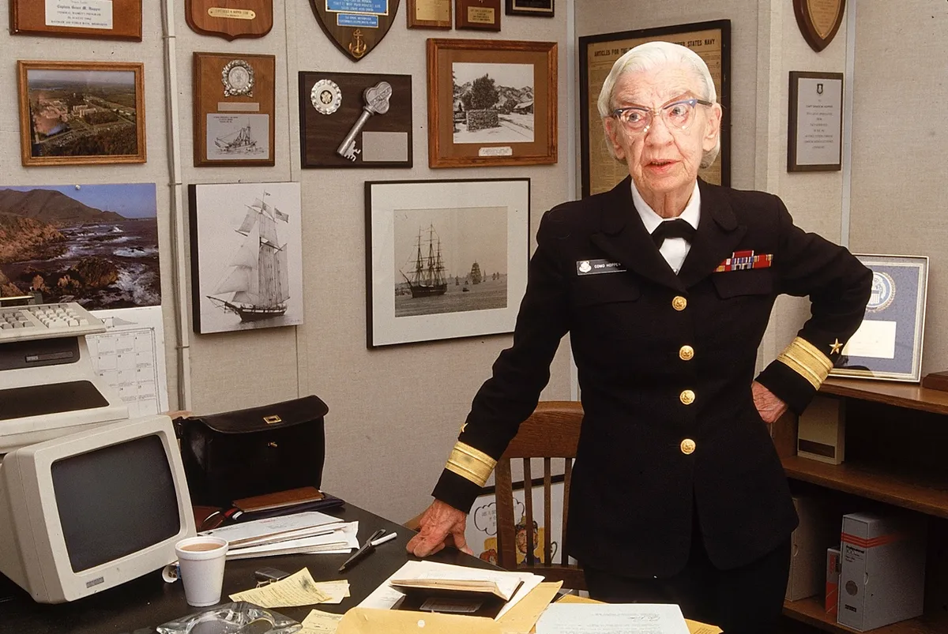
Grace Hopper
Pioneering computer programmer and one of the first women to achieve a PhD in mathematics

Slide 7
Valentina Tereshkova, First woman in space
On 16 June 1963 made space history by becoming the first woman in space. She orbited Earth 48 times in a mission that lasted nearly three days, and at the age of only 26 remains the youngest woman and the first civilian to visit space.

Slide 8
Jane Goodall
Primatologist who changed our understanding of chimpanzees.
Upon learning of the deforestation and cruelty devastating global wildlife, Dr Goodall turned her experienced hand to conservation and now travels extensively, inspiring the next generation to proactively safeguard endangered wildlife.

Slide 9
A list of questions that touch on the importance of women in science, their contributions, and the challenges they face
Why is it important to highlight the achievements of women in science?
What barriers have women faced in pursuing careers in science?
How can we encourage more young girls to pursue careers in science, technology, engineering, and mathematics (STEM)?
What role does gender equality play in scientific innovation and discovery?
Who are some of the most influential women in science, and what are their contributions?
How can scientific institutions better support women in research and academia?
How have women in science fought for equal opportunities and rights throughout history?
What initiatives or programs have been most successful in promoting gender equality in STEM?
How do women scientists contribute to making science more inclusive and accessible to diverse communities?
What are some of the unique perspectives that women bring to scientific research and problem-solving?
How can mentors and role models inspire more women to enter and succeed in science careers?
What are the benefits of increasing the number of women in scientific fields?
How can we address unconscious bias in scientific research and academia?
How has the recognition of women in science changed over time, and what further steps need to be taken?

Slide 10
To all women scientists, and women working in science, happy International day of Women and Girls in Science !
Notes:
To all women scientists, and women working in science, happy International day of Women and Girls in Science !

